Slide 1

DriverPass
System Analysis
Mitchell Ramirez
Notes:
[No speaker notes required for this slide.]

Slide 2

System Requirements
Functional requirements
  Validate users when logging into the system
  Tracking the progress of each user in the dashboard
Non-functional Requirements
  Cloud-based server-host
  Supporting for fast video streams
Notes:
Some of the functional requirements at DriverPass are things that the program will be expected to do. First will be validating user logins since this will be essential to maintaining a secure and private testing environment, especially majority of the users will be under 18 or the parents of said minors. The dashboard will display the sensitive information about the user’s progress, and as well as their personal information. Validating the credentials will help ensure they only see their own dashboards and only their own personal information. Exactly how will the user access the DriverPass program? Through a web browser such as Google Chrome and Safari. This means the application will be hosted on a server, preferably from a third-party, so that DriverPass does not have to worry about the maintenance of the server. The server host will need to be able to support a fast delivery of content, since that is one of the features of DriverPass is streaming driving instructions videos. With the videos being accessed potentially by multiple people at once, they will need to be hosted on a platform that can keep up with the demand, especially during the peak hours of the day, e.g. after work hours, school, or after dinner time.

Slide 3
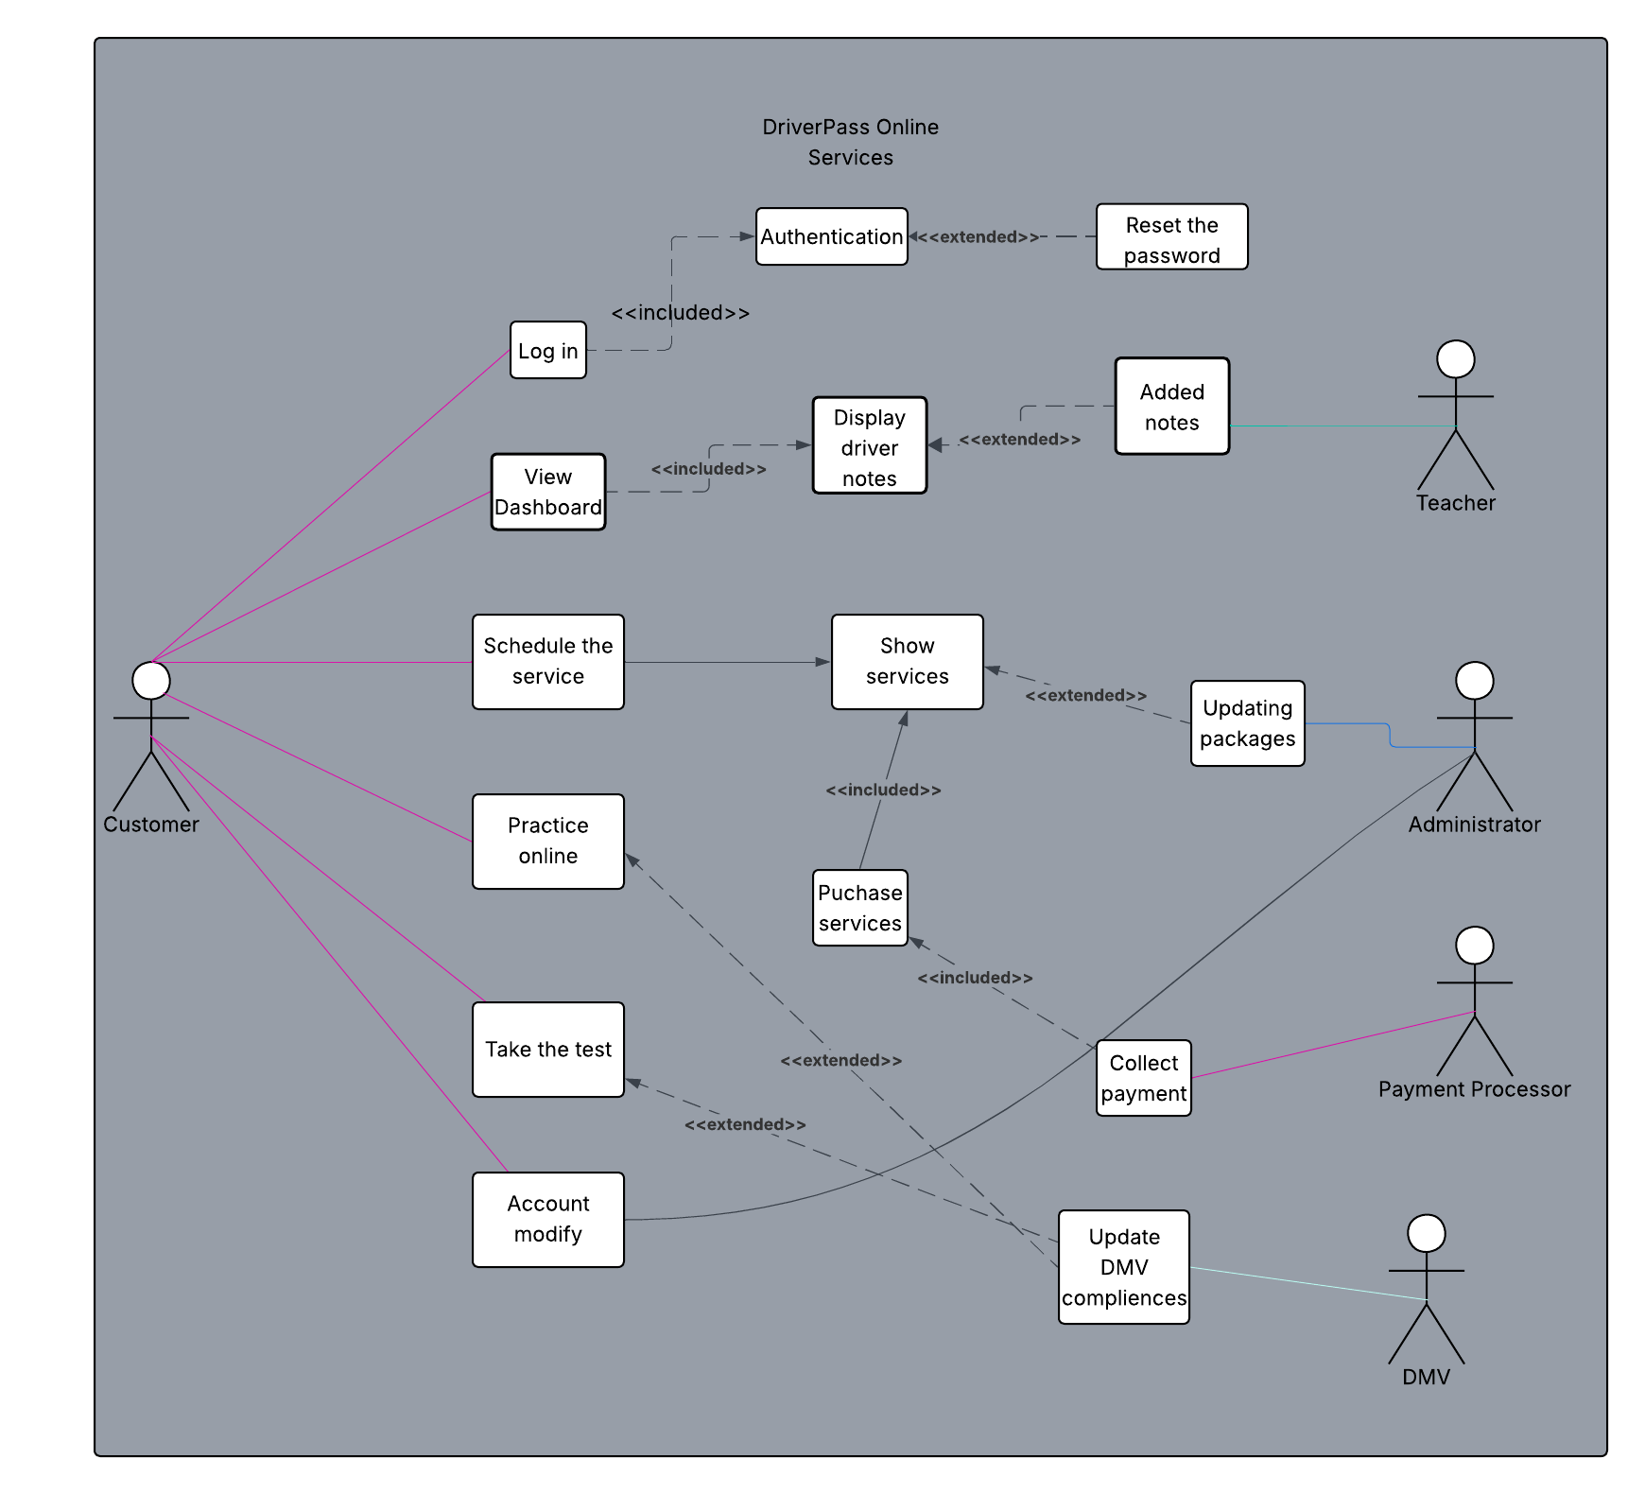
Use Case Diagram
Notes:
The DriverPass application is expected to perform a wide array of tasks, as demonstrated here in the diagram. Once the user logs into the DriverPass application, they will be met with the dashboard that allows them to select a myriad of items, including an option to take practice tests, schedule the driving training, or watch the various online practice videos. The content will be designed to help the drivers learn what they need in order to pass the driving and written portions at the DMV, which will be updated through a special service that will connect DriverPass to the DMV. These services will be offered by DriverPass (at the moment, the three different tiers of testing) will be updated by the admin when they are needed to. When the dashboard is displayed to the user, any notes from their instructors from the previous lessons will be shown here. For new users, this will not be displayed to them. The admin and users will have the ability to modify the users accounts, as the administrators are expected to also help the users and assist them in purchasing the services over the phone.

Slide 4
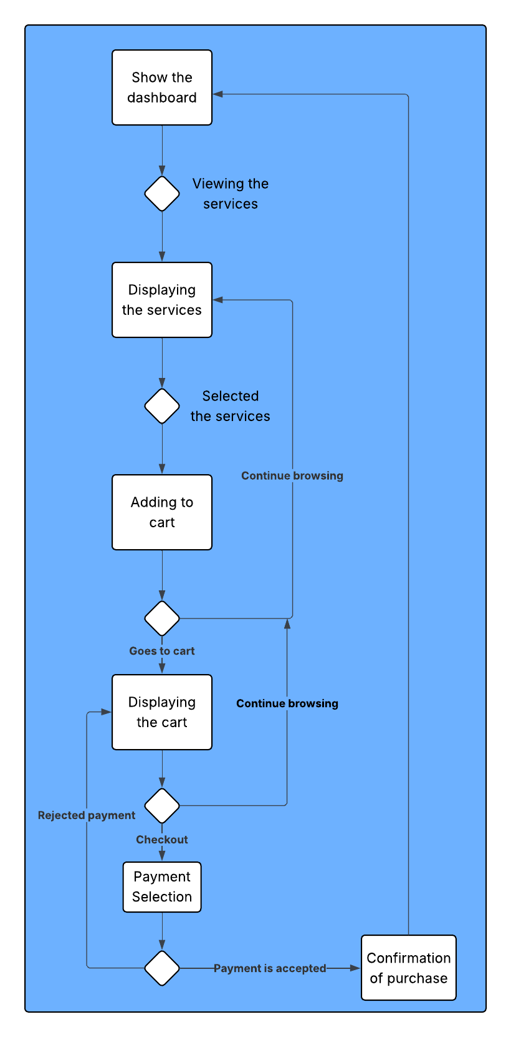
Activity
Diagram
Notes:
Here is a sample of what the user of DriverPass might do while on the application. We begin with the user dashboard; the user decides to look at the driving instructors and services that DriverPass offers. The system will display the services available in an easy to digest view. Should the user choose a service for purchasing, it will be added to their shopping cart for them to purchase later. At this time, the user can continue to browse the services offered or continue with the purchase by allowing the user to display the cart. From within the shopping cart, the user may go again and continue browsing or proceed to checkout the services. From here, it will display if they either want to use a previously saved payment method or input a new payment. The payment is then processed by a third-party and if the payment is verified and accepted, DriverPass will send the customer a confirmation messages and then an email to them on their account and then returned to the main menu. However, if the payment is rejected from the payment service, the user is returned to their cart, and the checkout process is started over. Or the user can continue browsing the services.

Slide 5
Security
Maintain Security
  Every user must have a unique username
  12-character minimum password
    Variety of upper- and lower-case letters, numbers, and special characters
  Mandatory multi-factor authentication
  5 attempts for login
  Website will have TLS on by default
  Encrypting the user information on the server and database
Notes:
Since user information at DriverPass is sensitive, it is with utmost importance to consider security to be a priority when we are designing certain parts of the application. When the users are logging in to the first time, the user will be prompted to create an ID and password; and each UserID must be unique from any other user’s IDs. This will be chcked as they create the ID. Furthermore, the users will be creating a password that meets the minimum requirements since as the minimum length of 12 characters, including at least one upper- and lower-case letters, a number, and a special character. Their username will not be allowed to be the same as their password and vice versa; and it cannot be an easy password either like 1234, password, etc. User must turn on multi-factor authentication. If the user attempts to log into the system more than a set number of times unsuccessfully, the account will be locked and they will be directed to contact the support (or admin) to give them access to their account again and then reset their password. The user data is to be stored on a server that is encrypted, no plain-text or payment information will be available in case of security breaches.

Slide 6
System Limitations
Limitations of the Proposed Design
  Users
    What browser are they using?
    What is their internet situation?
  Streaming
  Outside of network connections
Notes:
Based on this proposed design, I can see several potential issues that may arise out of this system. The first, and most importantly, is how users will be accessing the system. Since this is supposed to be a web-based software, the users will need an always online internet connection and an up-to-date browser such as Google Chrome or Firefox. On top of that, their individual connection speeds will be a factor because they may or not be reliable enough to deliver the video content fast enough. Different web browsers exists, and even though it is a web-based software, DriverPass cannot make it work on everything in the world. Therefore, the application should be developed with the top browser in mind (Chrome, Safari, Firefox, Edge). Video streaming on DriverPass will be another issue because all of the files would be hosted in one place. While many users may access the content, streaming may become slowed; thus, requiring a hosting company with a fast internet connection that is also able to support fast and multiple connections, such as the UDP protocol. Lastly, the application is relying heavily on outside services (for example the DMV compliance updates) and if the servers go down, how would this affect DriverPass? It is the utmost importance to design the application to be able to function even when the services become unavailable. The users will still need to be able to view the services available and be able to view their dashboard or practice tests. If the payment system goes down, the users will still have their items in their carts for purchasing later. Services will be available for the customers to have a last updated notification to show how recent the DMV update was taken place.

